Slide 1
Act 1: Binary Session Types
With a deeply embedded binder representation.

Slide 2
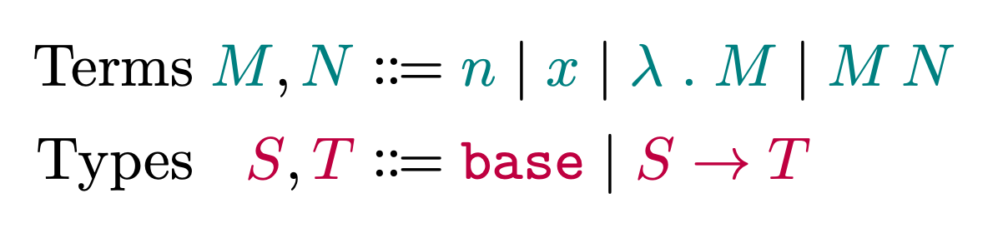
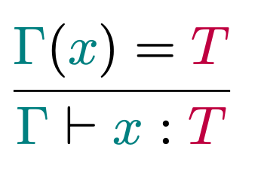
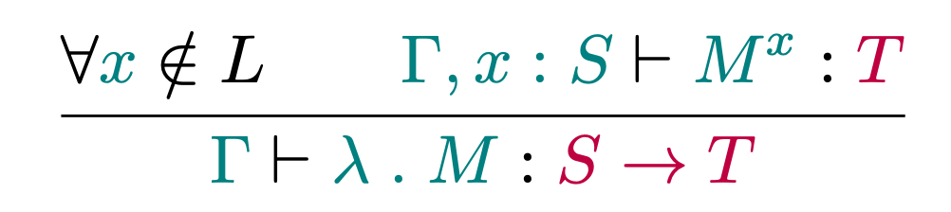
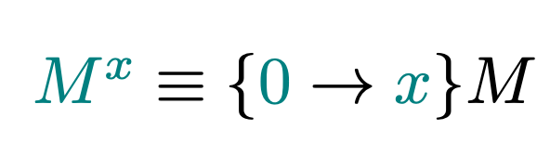
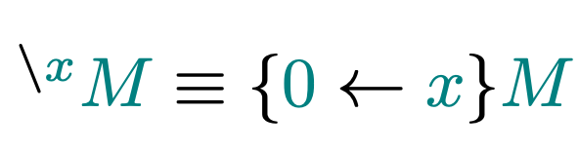
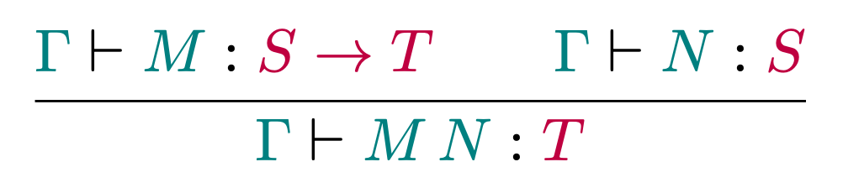
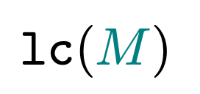
Locally Nameless
with the Simply Typed Lambda-Calculus.
Bound variables are represented by their De Bruijn index (i.e: a natural number).
Free variables are represented by a name (i.e: an element of a nominal set).
Binders are anonymous (as with De Bruijn indices in general).
C
Open a term.
Close a term.
A locally closed term.

Slide 3
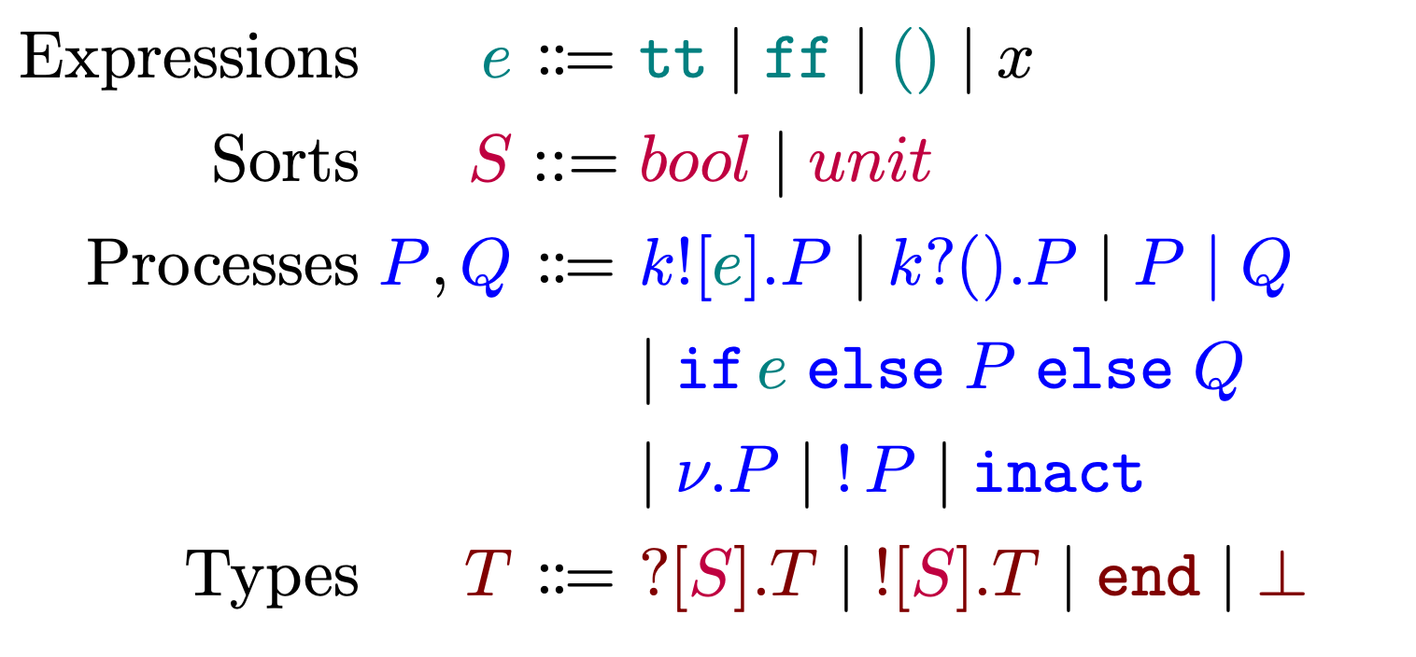
smolEMTST
A simple calculus with binary session types.
expression variables
channel variables

Slide 4
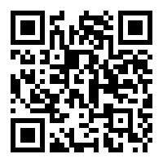
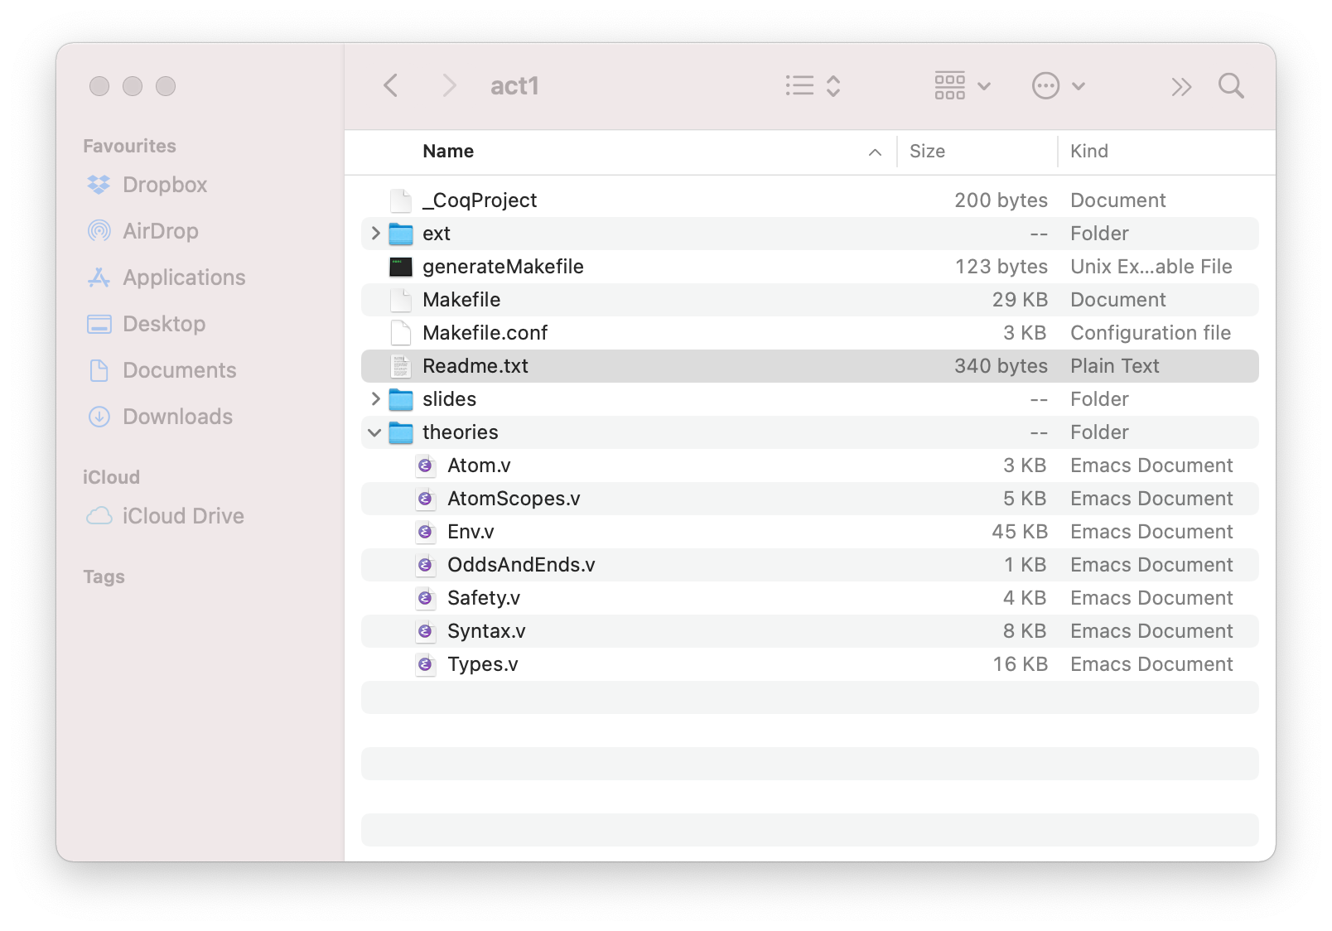
smolEMTST
At: http://github.com/emtst/gentleAdventure
EMTST the tool:
multiple name scopes
environment handling

Slide 5
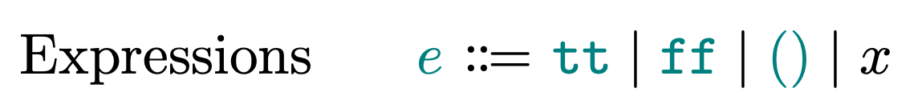
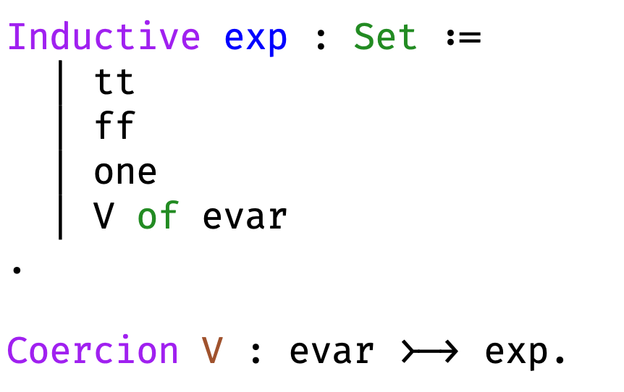
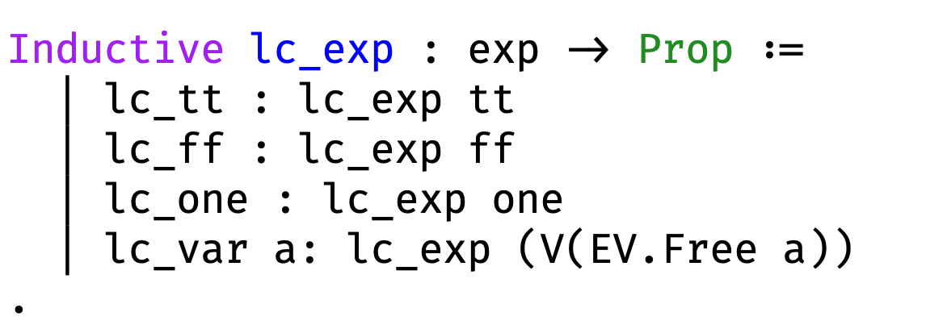
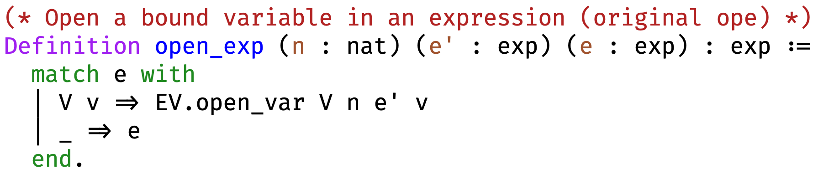
Representing the Syntax.
Locally closed brings the binding structure.

Slide 6
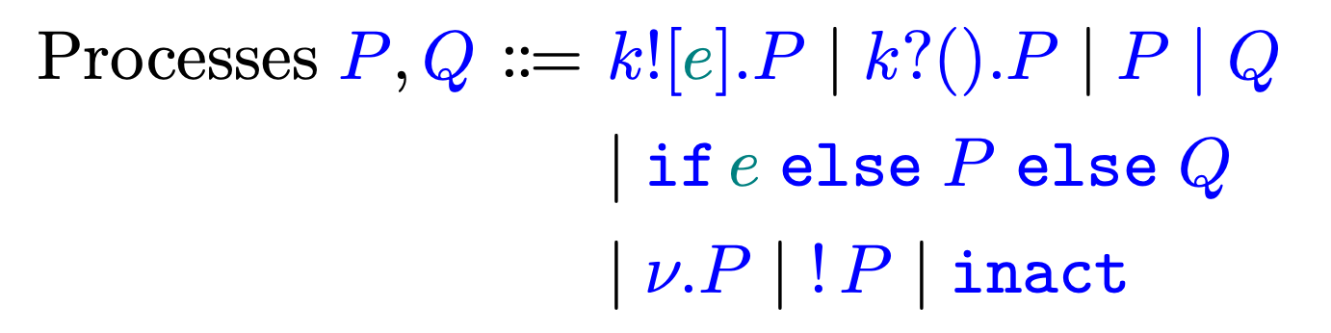
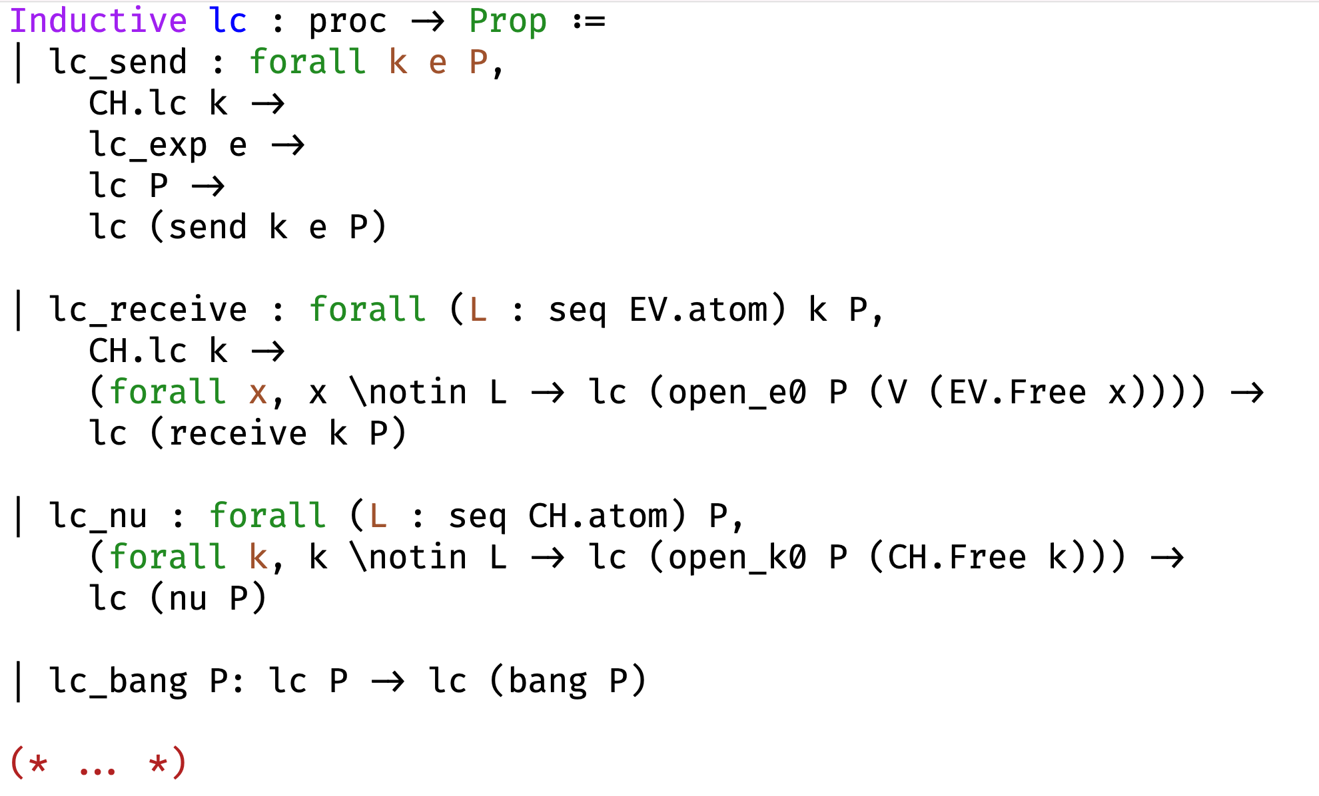
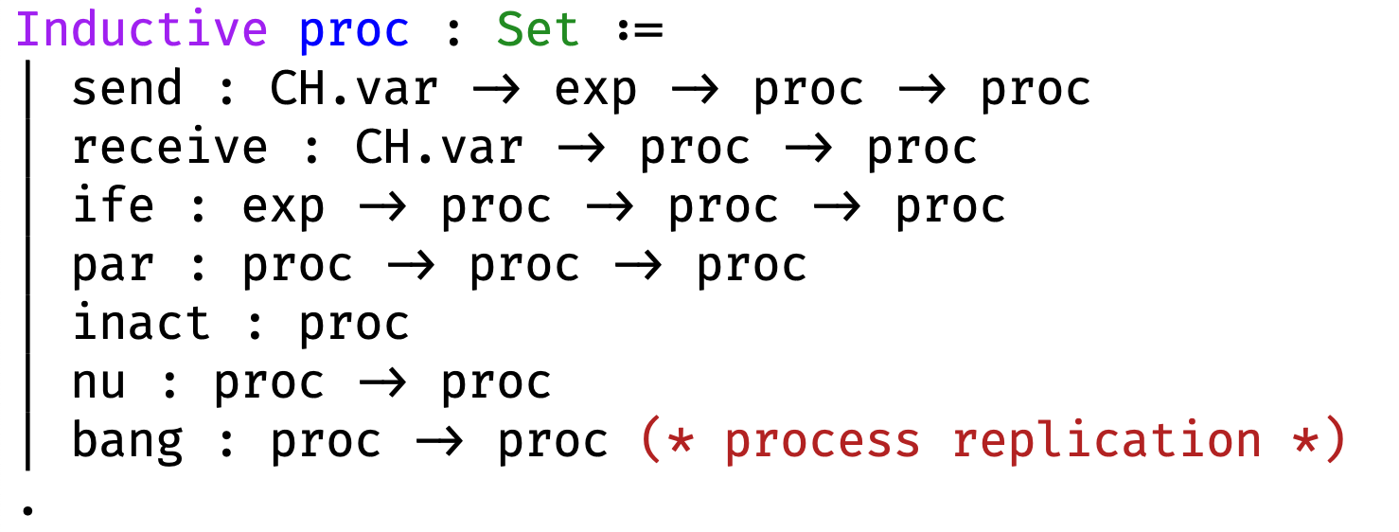

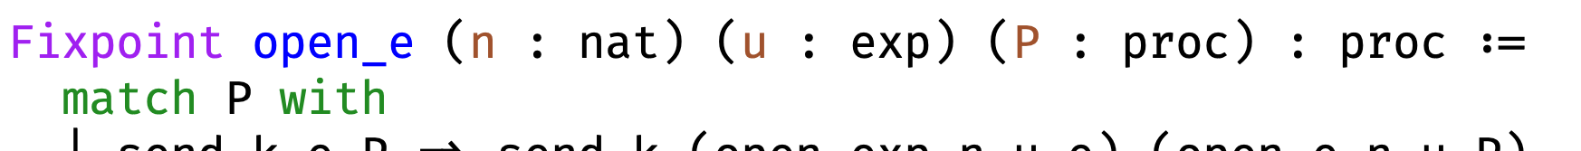

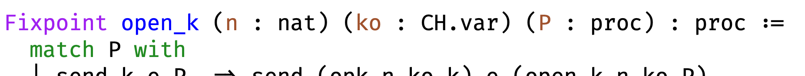
The Syntax of Processes
Remember, locally closed brings the binding structure.

Slide 7
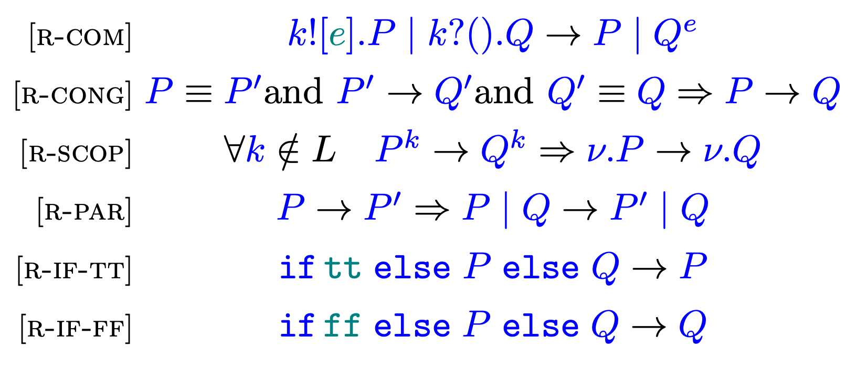
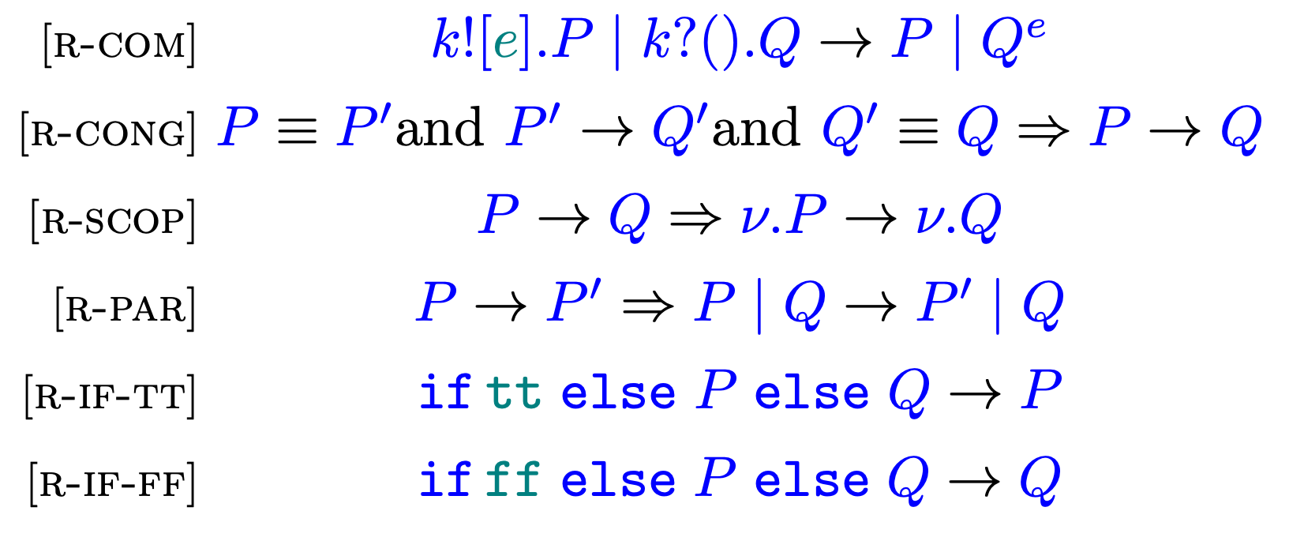
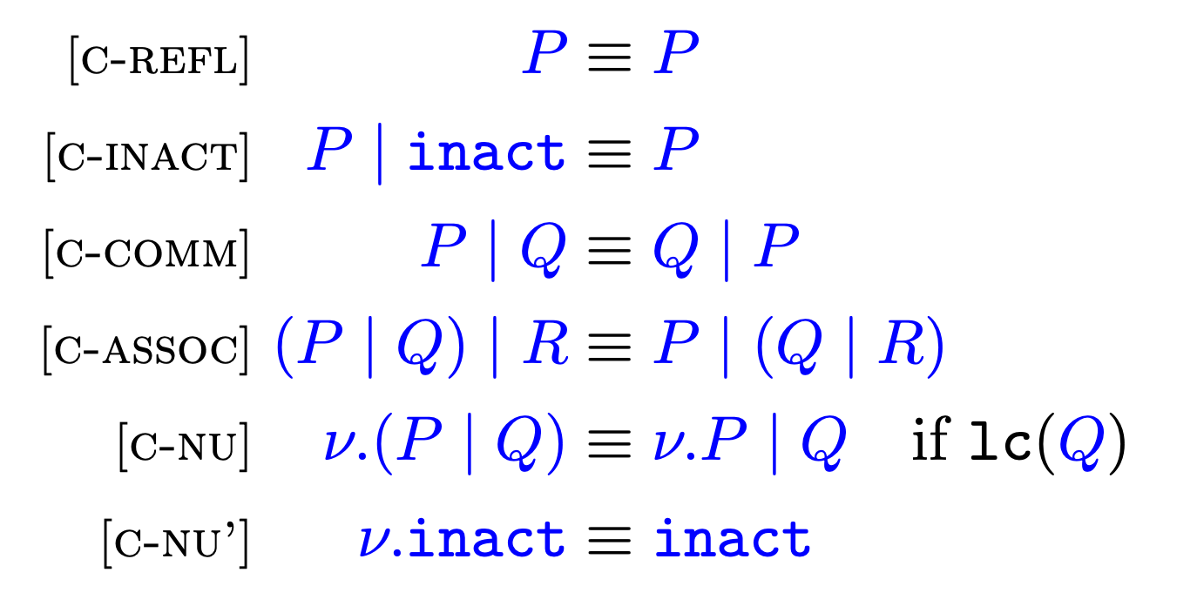
Congruence and Reduction
Keeping an eye on locally nameless.

Slide 8
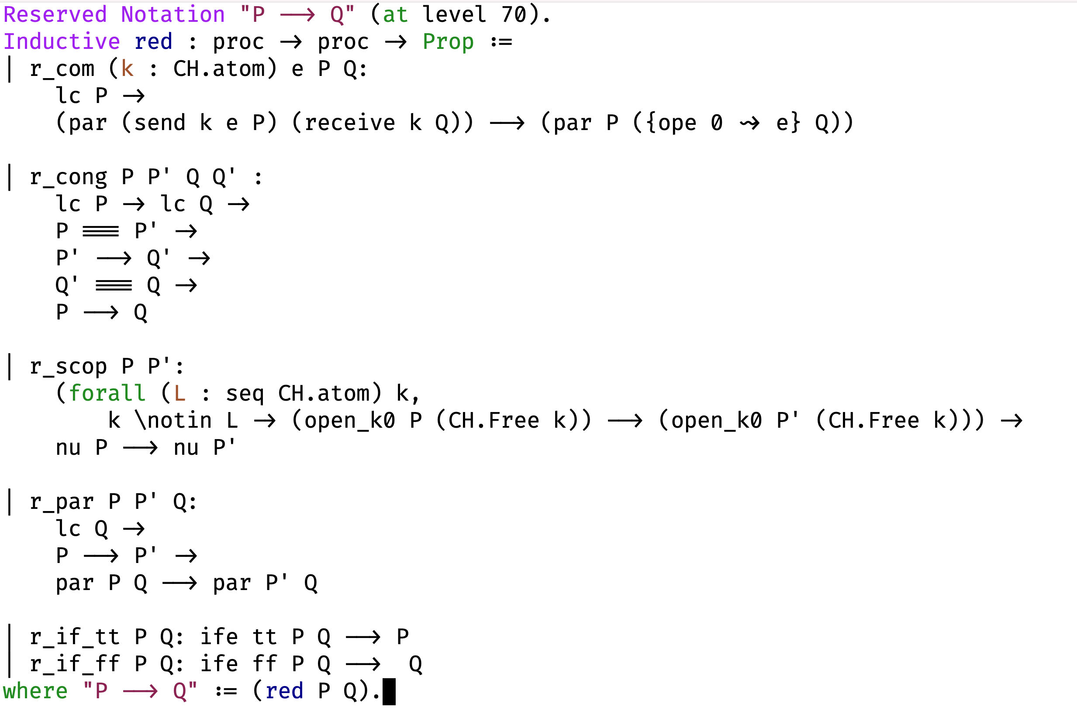
Representing Judgments
It’s really nothing new.

Slide 9
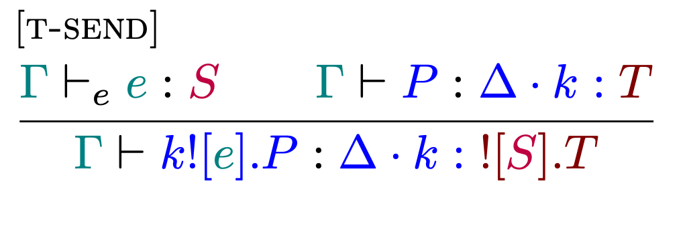
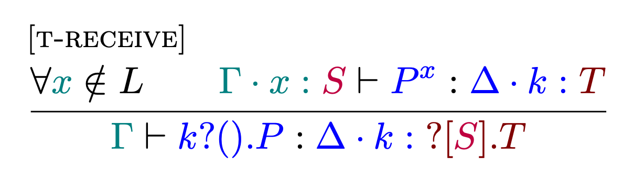
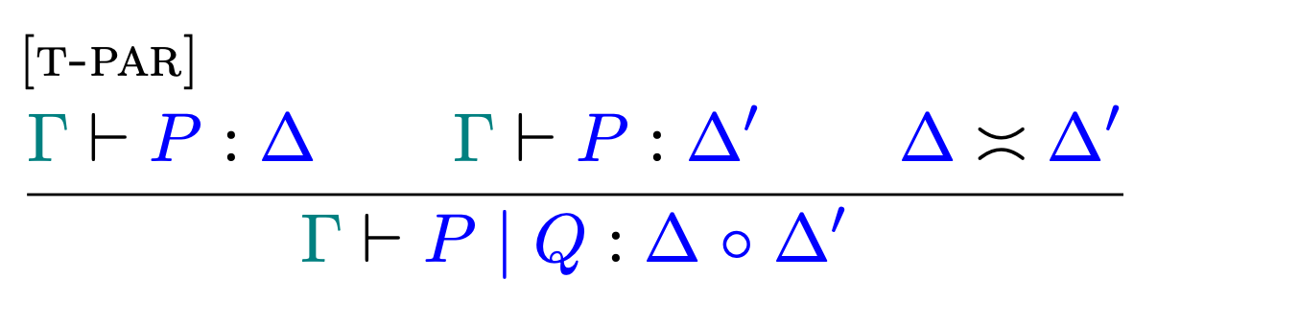
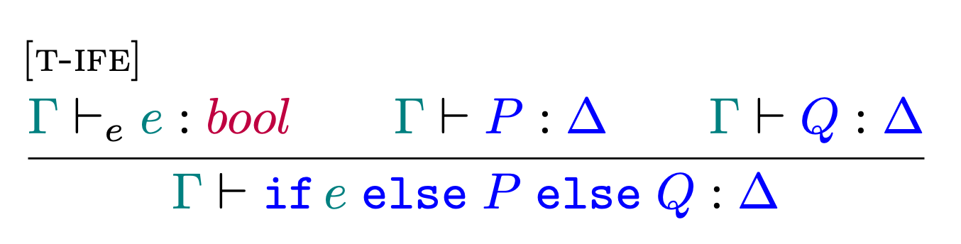
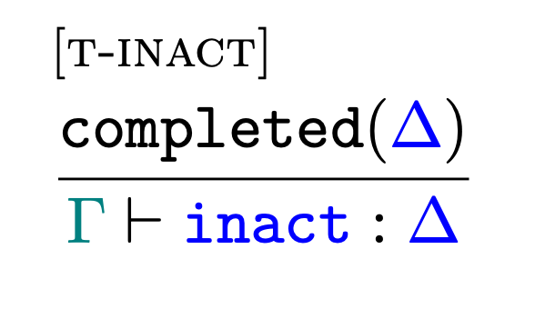
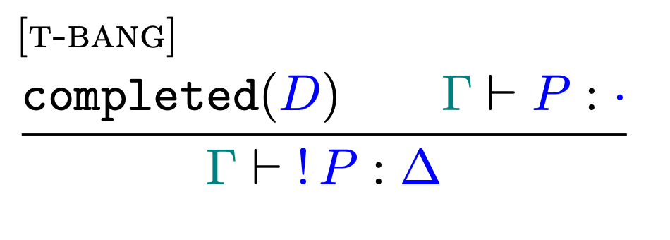
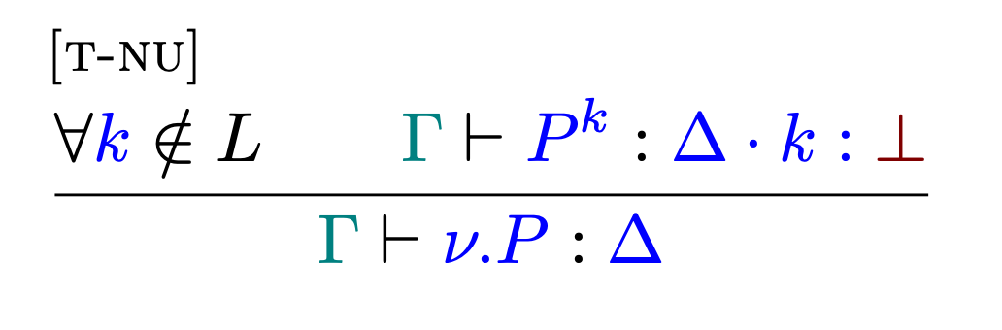
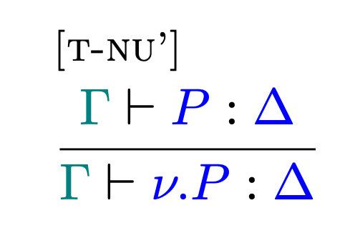
Typing smolEMTST
Locally nameless became easy by now.

Slide 10
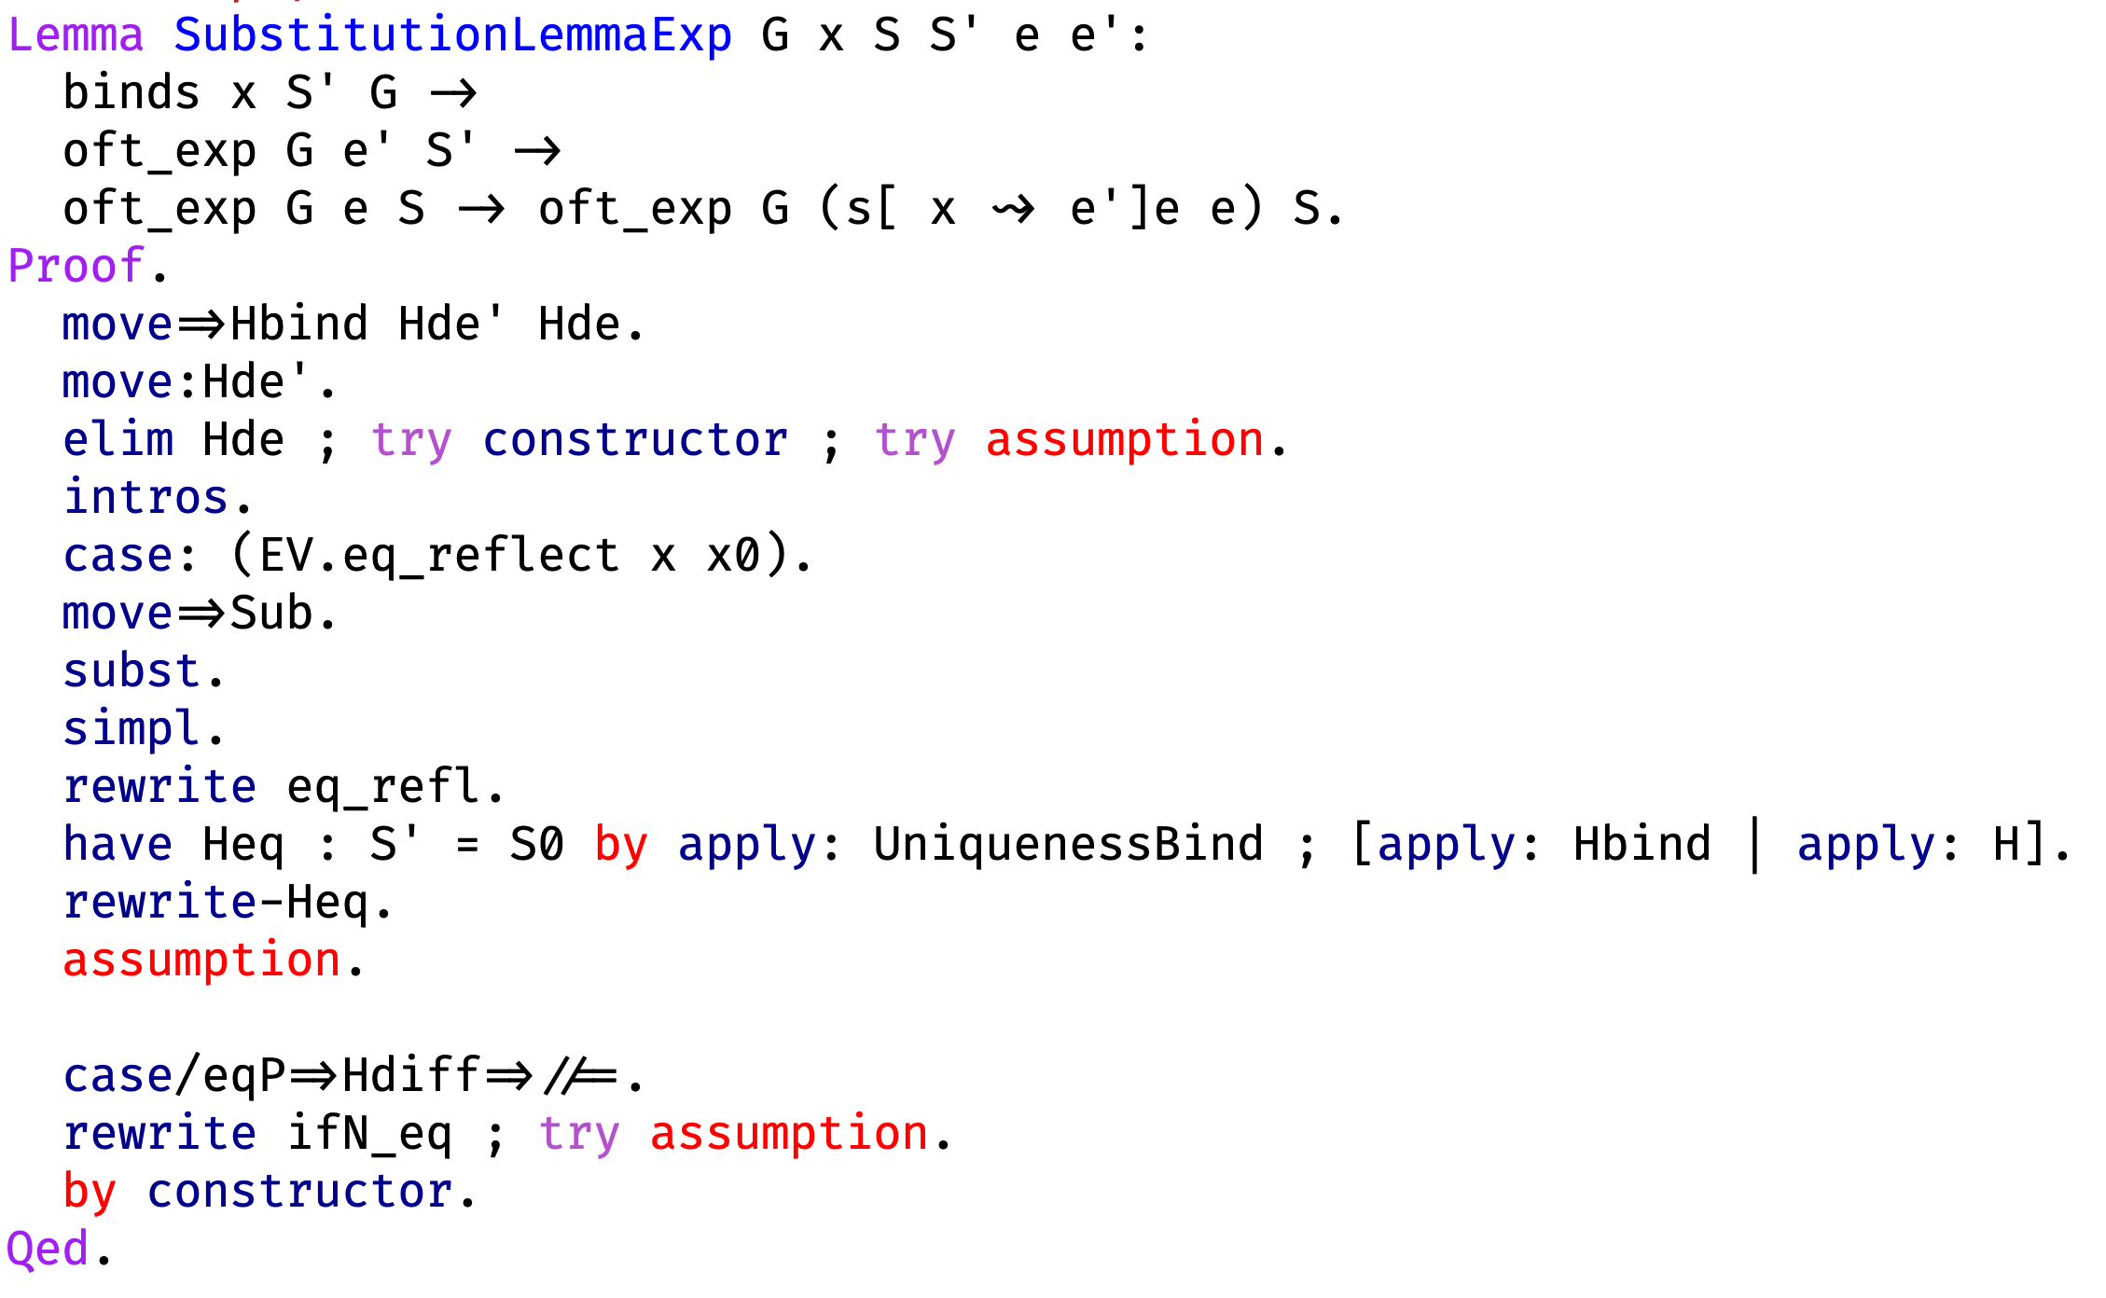
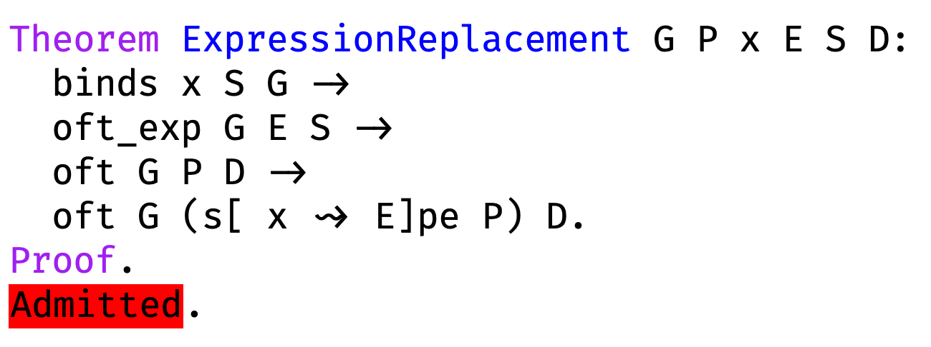
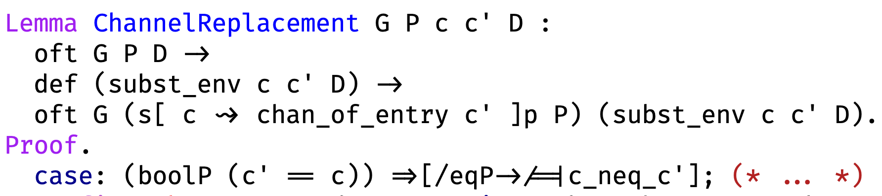
Substitution Lemmata
Because one lemma is not enough.
Substitutes expressions in processes

Slide 11
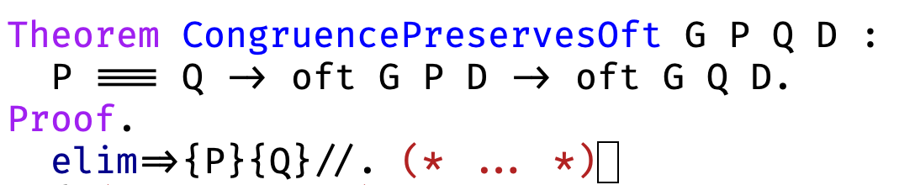
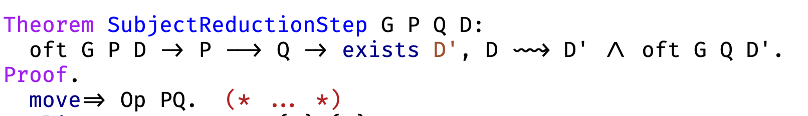
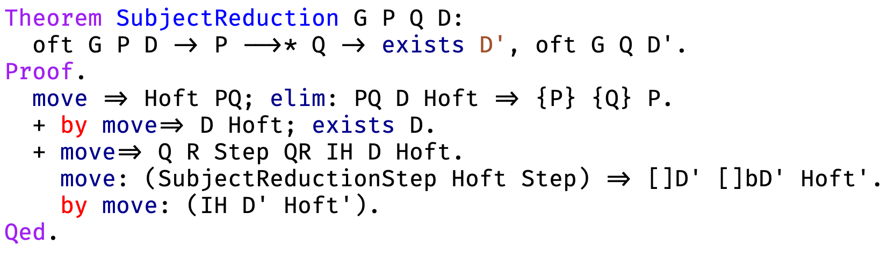
Subject Reduction
These proofs will motivate some other lemmas (e.g: weakening).

Slide 12
Conclusion of the First Act.
No intermediate and no tiny ice cream like at the theatre.
Deep embedding (LN) binders allows us to fully control the calculus.
LN demands tribute for that control (in the shape of theorems).
EMTST (the tool) helps with nominal sets and environments.
In the next act we explore what do we get if we give up control (using shallow embeddings).

